Slide 1
Smart Ocr Application For Document Digitization
Team members:
1.P.Praneeth kumar-19R11A04J0
2.Reddy Rajula Udaykiran-19R11A04J3
3.Shaik Mohammad Siddique-19R111A04J4
4.Somireddy Bhavani Prasad-19R11A04J6
5.Tanniru.Sravani-19R11A04J7

Slide 2
Introduction:
OCR, or Optical Character Recognition, is a process of recognizing text ould be of handwritten text, prinside images and converting it into an electronic form. These images cinted text like documents, receipts, name cards, etc., or even a natural scene photograph.
There are 2 different techniques in optical character recognition: pattern recognition and feature extraction. Pattern recognition refers to recognize characters in their entirety. Feature extraction means detecting the individual lines and strokes characters are made from and identifying them that way
OCR accuracy can be measured by the portion of characters in a text that the OCR tool can extract extract without mistakes. For example, 99% accuracy means that 990 out of 1000 characters are correctly recognized.
At the start of the digital revolution, when most of the printed information was being uploaded on the web, manual data entry of such humongous printed data (like those of newspaper collections) became a task that required time and patience. This data entry task was also prone to human errors. The outcome of this problem was in the form of the birth of OCR. It was invented in the early eighties. OCR is now mature enough to grab characters and words from images to extract meaningful information. This technology has now attained a near-perfect text detection accuracy.

Slide 3
Increased Security: Physical documents cannot be tracked but scanned documents can be tracked. The access to the digitized documents can also be restricted.
Saves Space: Digital storage spaces are way cheaper to take on rent than physical spaces. Eliminating the need for paper storage can help save more space, thereby reducing the requirement of physical space.
Risk Mitigation: In case of a natural or manmade disaster, the risk of losing physical documents is mitigated by digitizing them.

Slide 4
Problem Statement:
The problem here for the software system to recognize characters in computer system.
when information is scanned through the paper documents as we know that we have number of news papers and books which are in printed format related to different subjects. Whenever we scan the documents through the scanners, the document are stored as images such as jpeg,gif etc.., in the computer systems .these images cannot or edited by the user.
But to resue these information it is very difficult to read the individuals contents and searching the contents from these documents line-by-line and word by word .these days there is is a huge demand in "storing the information available in this paper documents in to a computer storage disk and then later editing or reusing this information by searching process".

Slide 5
Proposed Solution:
Our proposed System is OCR .Which is a character recognition system that supports recognition of characters of multiple languages. OCR software processes a digital image by locating and recognizing characters, such as letters, numbers, and symbols. Some OCR software will simply export the text, while other programs can convert the characters to editable text directly in the image. Advanced OCR software can export the size and formatting of the text as well as the layout of the text found on a page. It supports multiple functionalities to be performed on the document .
The multiple functionalities include editing and searching.

Slide 6
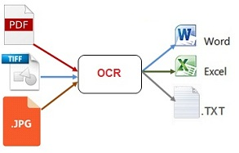

Slide 7
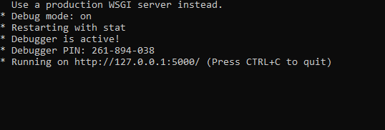
Output:

Slide 8
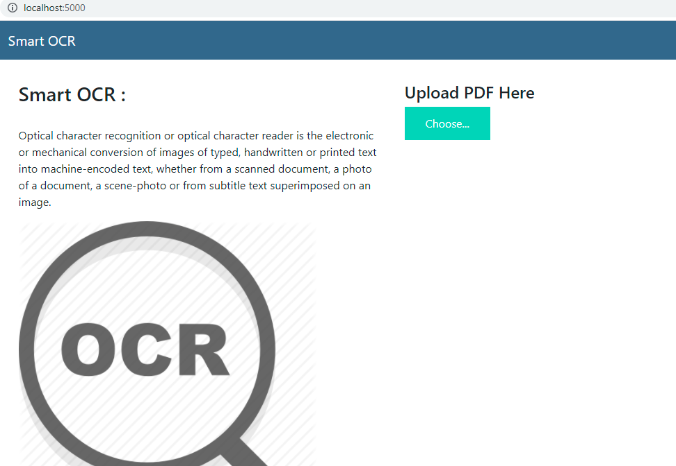

Slide 9
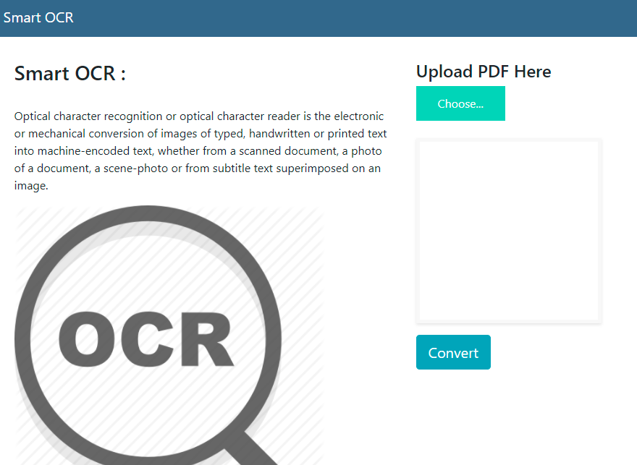
Choose the pdf from the folder called upload.
click on convert .

Slide 10
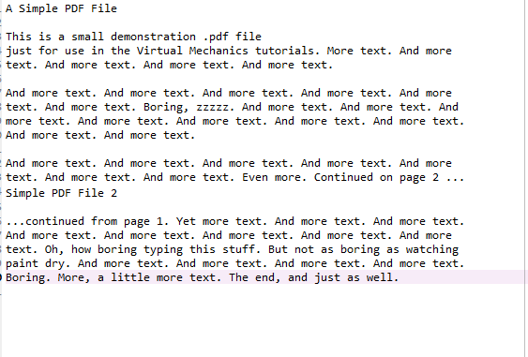
When we click on convert.
It will extracted in to the text format.

